Slide 1
DIGITAL TRANSMISSION OF DIGITAL DATA
Sujoy Mukherjee

Slide 2
Baseband Transmission
Digital transmission is the transmission of electrical pulses. Digital information is binary in nature in that it has only two possible states 1 or 0. Sequences of bits encode data (e.g., text characters).
Digital signals are commonly referred to as baseband signals.
In order to successfully send and receive a message, both the sender and receiver have to agree how often the sender can transmit data (data rate).
Data rate often called bandwidth – but there is a different definition of bandwidth referring to the frequency range of a signal!

Slide 3
Baseband Transmission
With unipolar signaling techniques, the voltage is always positive or negative (like a dc current).
In bipolar signaling, the 1’s and 0’s vary from a plus voltage to a minus voltage (like an ac current).
In general, bipolar signaling experiences fewer errors than unipolar signaling because the signals are more distinct.

Slide 4
ANALOG TRANSMISSION OF DIGITAL DATA
Analog Transmission occurs when the signal sent over the transmission media continuously varies from one state to another in a wave-like pattern.
e.g. telephone networks, originally built for human speech rather than data.
Advantage for long distance communications: much less attenuation for analog carrier than digital

Slide 5
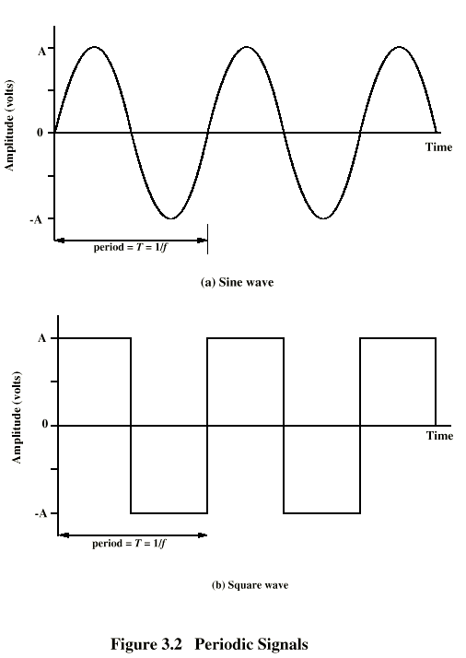
Periodic
Signals

Slide 6
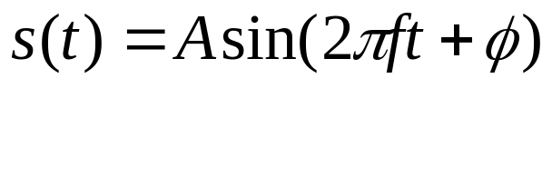
Sine Wave
Peak Amplitude (A)
  maximum strength of signal
  volts
Frequency (f)
  Rate of change of signal
  Hertz (Hz) or cycles per second
  Period = time for one repetition (T)
  T = 1/f
Phase (φ)
  Relative position in time, from 0-2*pi
General Sine wave

Slide 7
Wavelength
Distance occupied by one cycle
Distance between two points of corresponding phase in two consecutive cycles
λ = Wavelength
Assuming signal velocity v
  λ = vT
  λf = v
  c = 3*10⁸ ms⁻¹ (speed of light in free space)

Slide 8
Frequency Domain Concepts
Signal usually made up of many frequencies
Components are sine (or cosine) waves
Can be shown (Fourier analysis) that any continuous signal is made up of component sine waves
Can plot frequency domain functions

Slide 9
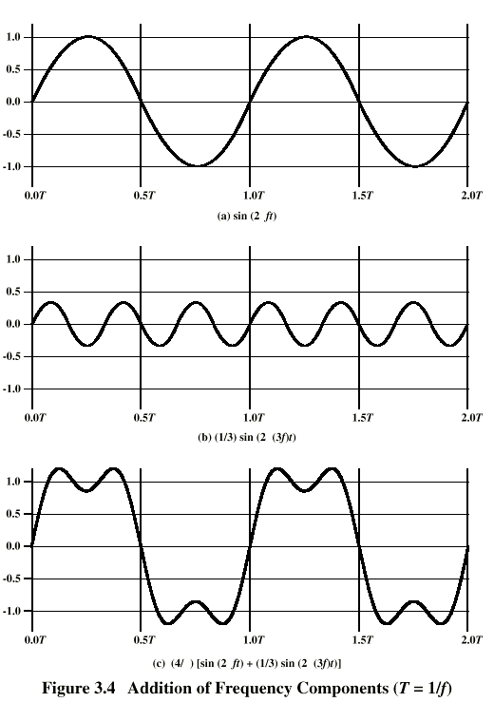
Addition of
Frequency
Components
Notes:
2nd freq a multiple of 1st
1st called fundamental freq
Others called harmonics
Period of combined =
Period of the fundamental
Fundamental = carrier freq

Slide 10
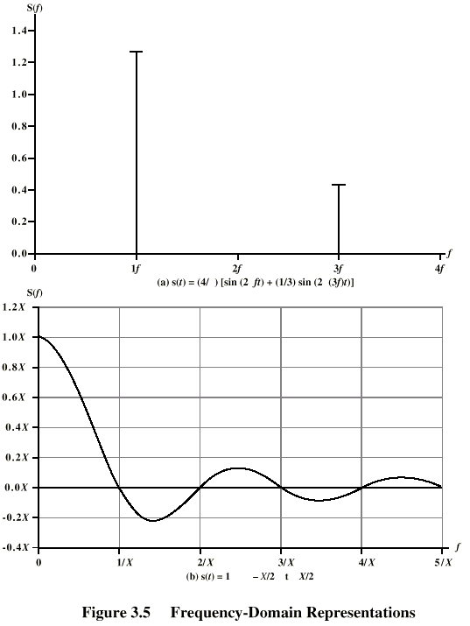
Frequency
Domain
Discrete Freq Rep:
Any continuous signal can be represented as the sum of sine waves! (May need an infinite number..)
Discrete signals result in
Continuous, Infinite Frequency Rep:
s(t)=1 from –X/2 to X/2

Slide 11
Data Rate and Bandwidth
Any transmission system has a limited band of frequencies
This limits the data rate that can be carried
Spectrum
  range of frequencies contained in signal
Absolute bandwidth
  width of spectrum
Effective bandwidth
  Often just bandwidth
  Narrow band of frequencies containing most of the energy

Slide 12
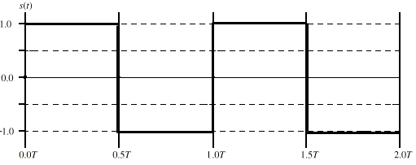
Example of Data Rate/Bandwidth
Want to transmit:
Let’s say that f=1Mhz or 10⁶ cycles/second, so T= 1microsecond
Let’s approximate the square wave with a few sine waves:

Slide 13
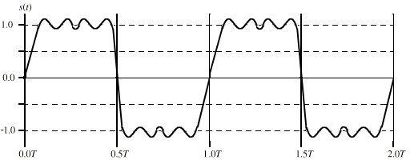
Ex(1): Sine Wave 1
Bandwidth=5f-f =4f
If f=1Mhz, then the bandwidth = 4Mhz
T=1 microsecond; we can send two bits per microsecond so
the data rate = 2 * 10⁶ = 2Mbps

Slide 14
Ex(2): Sine Wave 1, Higher freq
Bandwidth=5f-f =4f
If f=2Mhz, then the bandwidth = 8Mhz
T=0.5 microsecond; we can send two bits per 0.5 microseconds
or 4 bits per microsecond, so the data rate = 4 * 10⁶ = 4Mbps
Double the bandwidth, double the data rate!

Slide 15
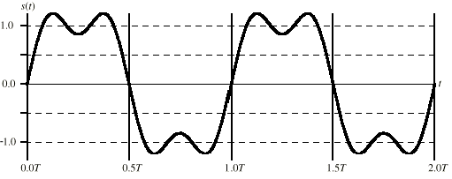
Ex(3): Sine Wave 2
Bandwidth=3f-f =2f
If f=2Mhz, then the bandwidth = 4Mhz
T=0.5 microsecond; we can send two bits per 0.5 microseconds
or 4 bits per microsecond, so the data rate = 4 * 10⁶ = 4Mbps
Still possible to get 4Mbps with the “lower” bandwidth, but our receiver must be able to discriminate from more distortion!

Slide 16

Bandwidth / Representation
2000 bps
B=500 Hz
B=1000 Hz
B=1700 Hz
B=4000 Hz
Increasing bandwidth improves the representation of the data signal.
500Hz too low to reproduce the signal. Want to maximize the capacity of the available bandwidth.

Slide 17
Multiplexers
A multiplexer puts two or more simultaneous transmissions on a single communications circuit.
Generally speaking, the multiplexed circuit must have the same capacity as the sum of the circuits it combines.
The primary benefit of multiplexing is to save money.

Slide 18
Multiplexing
There are three major types of multiplexers
Frequency division multiplexers (FDM)
  E.g. AM/FM Radio, Telephone
Time division multiplexers (TDM)
  ISDN
Wavelength division multiplexing (WDM)
  Used in optical carriers (colors carry signals)

Slide 19
Frequency Division Multiplexing (FDM)
Frequency division multiplexers can be described as dividing the circuit “horizontally” so that many signals can travel a single communication circuit simultaneously.
The circuit is divided into a series of separate channels, each transmitting on a different frequency.
Guardbands are employed to keep one channel from leaking over into another channel.
Frequency division multiplexers are somewhat inflexible because once you determine how many channels are required, it may be difficult to add more channels without purchasing an entirely new multiplexer.

Slide 20
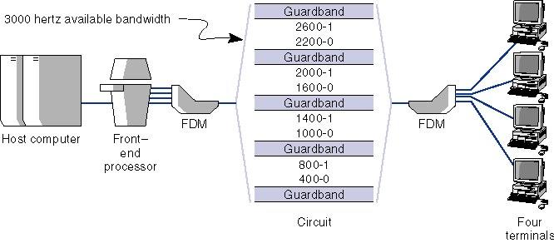
Frequency Division Multiplexing (FDM)

Slide 21
Time Division Multiplexing (TDM)
Time division multiplexing shares a circuit among two or more terminals by having them take turns, dividing the circuit “vertically.”
Time on the circuit is allocated even when data are not transmitted, so that some capacity is wasted when a terminal is idle.
Time division multiplexing is generally more efficient and less expensive to maintain than frequency division multiplexing, because it does not need guardbands.

Slide 22
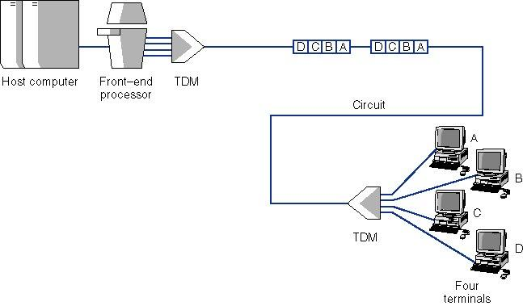
Time Division Multiplexing (TDM)

Slide 23
Transmission Impairments
Signal received may differ from signal transmitted
Analog - degradation of signal quality
Digital - bit errors
Caused by
  Attenuation and attenuation distortion
  Delay distortion
  Noise

Slide 24
Attenuation
Signal strength falls off with distance
Depends on medium
Received signal strength:
  must be enough to be detected
  must be sufficiently higher than noise to be received without error
Attenuation is an increasing function of frequency; higher frequencies suffer from more attenuation. Can distort the signal.
Solution: Equalization. Boost higher frequency components.

Slide 25
Delay Distortion
Only in guided media
Propagation velocity varies with frequency
  Velocity highest near center frequency
  Results in phase shift at different frequencies
  “Overlapping” bits
Solution: Equalization

Slide 26
Noise (1)
Additional signals inserted between transmitter and receiver
Thermal
  Due to thermal agitation of electrons
  Uniformly distributed
  White noise
Intermodulation
  Signals that are the sum and difference of original frequencies sharing a medium

Slide 27
Noise (2)
Crosstalk
  A signal from one line is picked up by another
Impulse
  Irregular pulses or spikes
  e.g. External electromagnetic interference
  Short duration
  High amplitude

Slide 28
What Causes Errors?
Summary of Errors and Noise:
Source of Error What Causes It How to Prevent It.
Line Outages
White Noise
Impulse Noise
Cross-Talk
Echo
Attenuation
Intermodulation
Noise
Jitter
Harmonic Distortion
Storms, Accidents
Movement of electrons
Sudden increases in electricity
(e.g. lightning)
Multiplexer guardbands too small,
or wires too close together
Poor connections
Graduate decrease in signal
over distance
Signals from several circuits combine
Analog signals change phase
Amplifier changes phase
Increase signal strength
Shield or move the wires
Increase the guardbands, or
move or shield the wires
Fix the connections, or
tune equipment
Use repeaters or amps
Move or shield the wires
Tune equipment
Tune equipment

